Slide 1

Students dropout and academic success prediction

Slide 2
Overview of the project
Every year, a large number of students dropout of school worldwide.
This involves economic and social factors of a country, directly impacting the lives of students and their families, higher education institutions, and society as a whole.
Education failure represents an obstacle to:
Economic growth.
Employment.
Productivity.

Slide 3
Description of the dataset
This dataset includes several attributes about social-economic factors and academic performance information, as well as demographic, socioeconomic and macroeconomic data.
The data sources used consist of internal and external data from the institution.
Academic Management System.
Support System for the Teaching Activity.
Annual data from the General Directorate of Higher Education.
Contemporary Portugal Database.

Slide 4
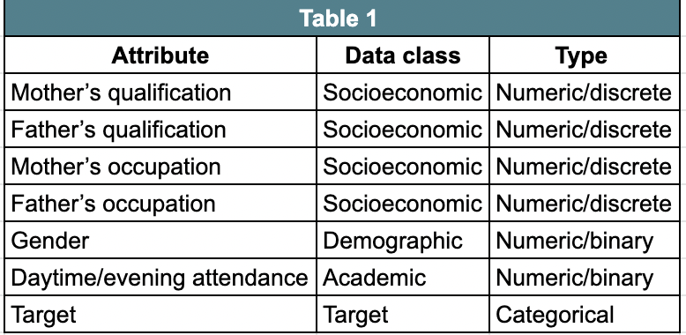
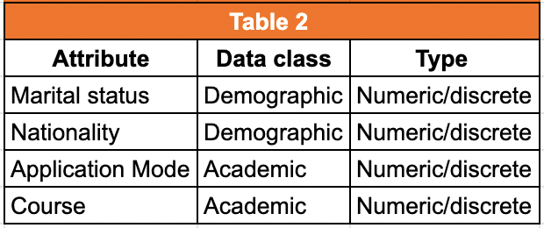
The data refer to records of students enrolled between the academic years 2008/2009 to 2018/2019 from 17 undergraduate degrees.
Final dataset is available as a comma-separated values (CSV) file encoded as UTF8.
Consists of roughly 3600 records.

Slide 5
Questions to answer with this dataset
Which are the highest risk factors for dropout?
Which factors are linked with student completion?
How do different features interact with each other?
By answering these questions, research insight is generated which will provide critical information for the formulation of strategies that promote successful degree completion among students from different backgrounds.

Slide 6
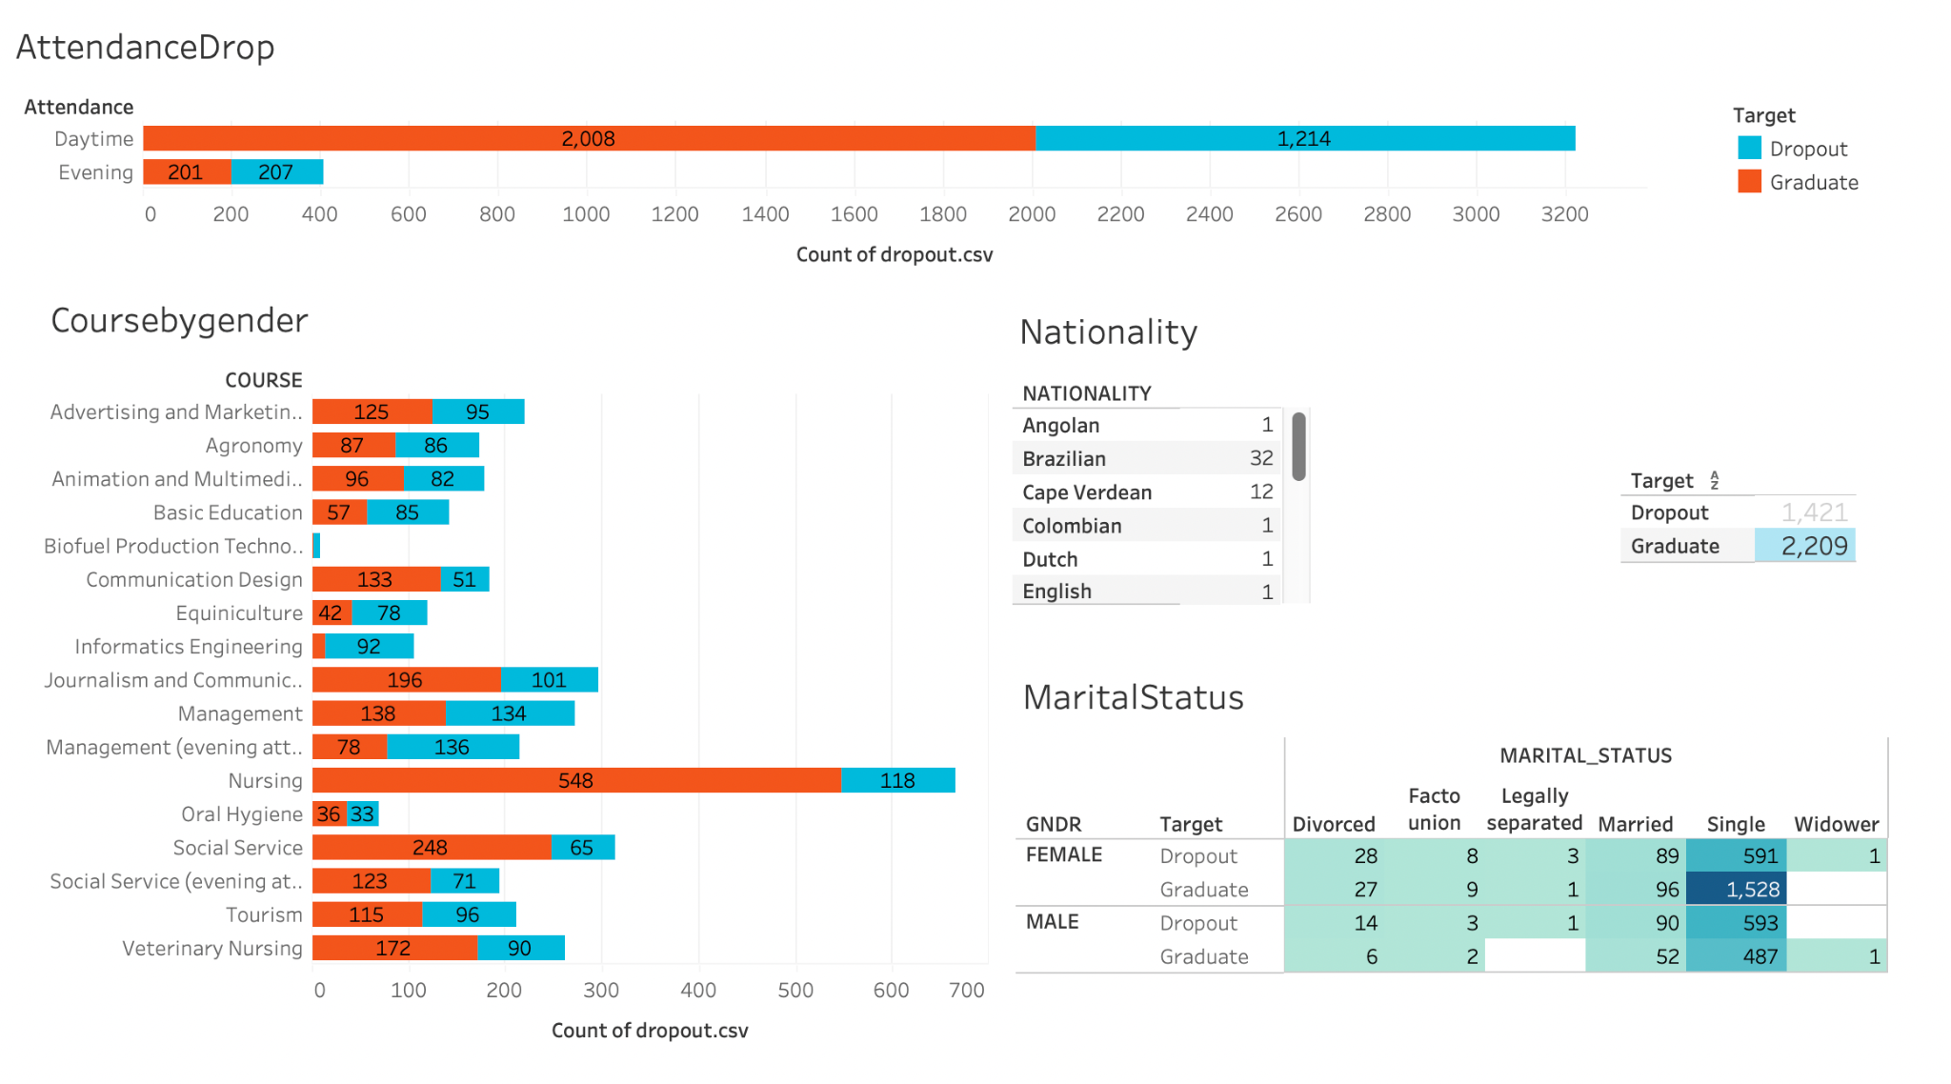
Data exploration phase

Slide 7
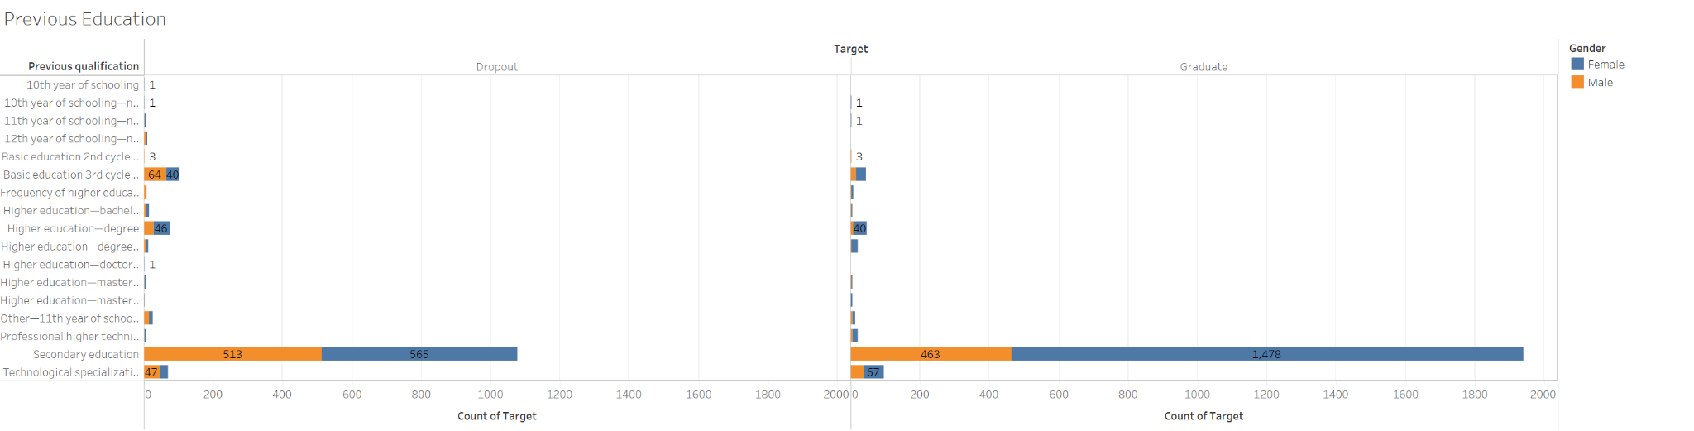
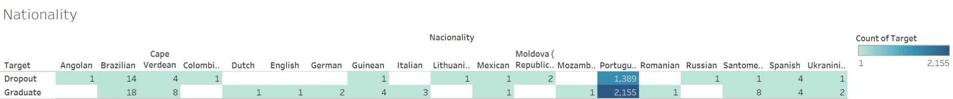
Data exploration phase
The majority of students have previously completed secondary education.

Slide 8
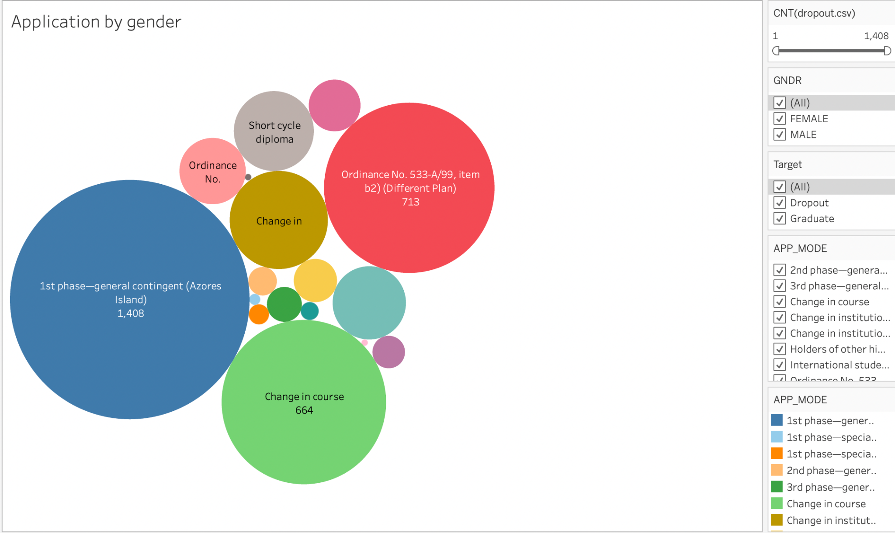
Data exploration phase

Slide 9
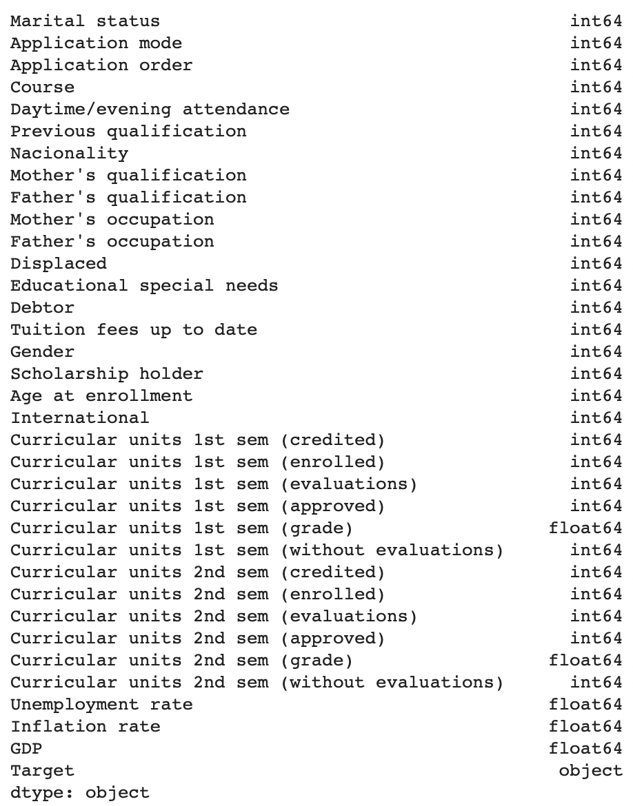
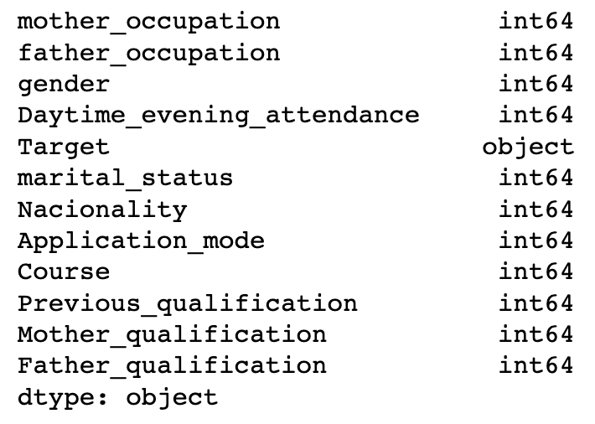
Data exploration phase
Cleaned Dataset, 12 columns
Original dataset, 35 columns

Slide 10
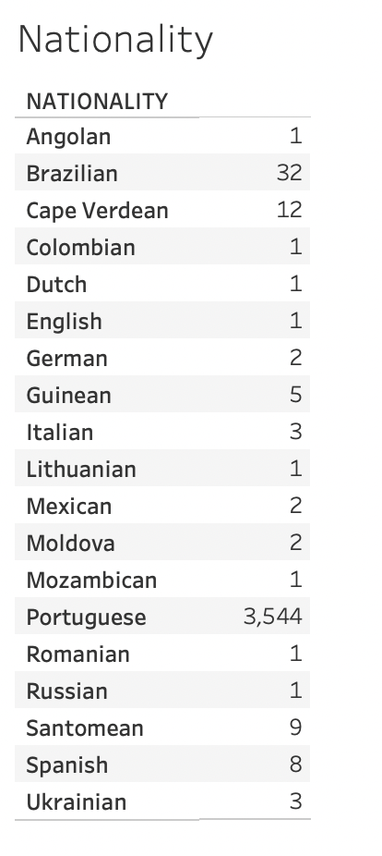
Data exploration phase
Data & Tools Extract: data source Kaggle
*Tableau & Python used exploration phase* Transform: Python in Jupyter Notebook
ex. Original Data Set from 35 to 11 columns Load: Storage: pgAdmin (SQL)
Analysis Jupyter Notebook (scikit-learn)

Slide 11
Description of the analysis phase
Objective: Identify the most important variables in the dataset for predicting dropout vs graduate status and whether any interactions between variables that are important for predicting the outcome.
Data Prep & Analysis (pandas) Python, Jupyter Notebook.
Machine Learning Algorithms (scikit-learn)
Random Naive Oversampling - 66.9%
Balanced Random Forest Classifier- 67.70%
Cluster Centroid Undersampling-90.70%

Slide 12
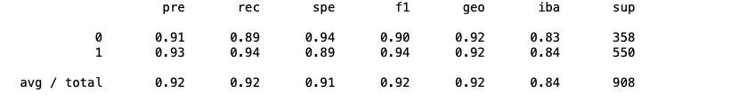
Results of the Analysis
After trying different approaches, we decided to stay with the Cluster Centroid Undersampling ML because of it preserves the distribution of the minority class, this makes the data more interpretable and easier to understand.
Using this model allowed us to reach the next results on precision, recall and f1.

Slide 13
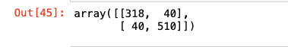
Results of the Analysis
We found 318 True Positives and 510 True Negatives on our results.

Slide 14
Recommendations for future Analysis
As part of our future recommendations, we would encourage the institution to either focus on increasing the market share of Nursing courses due to their high demand and the high number of graduate students in social service, journalism, and communication.
We highly recommend that for future analyses, we include the current residency of the students. While we know that 97.6% of our students are Portuguese, their residency country or area may differ significantly from each other.

Slide 15
Things done differently if we had more time.
With our advances predictive abilities, we can accurately identify which students are likely to graduate and which are at risk of dropping out. Based on this information, we can prioritize the allocation of scholarships to students who are more likely to succeed.
To facilitate this process, we propose the creation of an interactive webpage that would enable recruiters to quickly assess whether a student is a strong candidate for a scholarship at the time of application. This would streamline the selection process and ensure that scholarships are awarded to the most deserving and capable students and will make more financial sense to the institution.

